Slide 1

ALIBABA PROJECT
An e-commerce delivery platform

Slide 2
Use of LIP
The use of LIP had significant difference (>8% decrease) from no use of LIP in terms of total time (as well as long-haul time) taken to deliver items.
This cannot be said for the last mile delivery which took significantly less time to deliver for NO LIP orders.
LIP | Total Time (Hours) | Logistics Time – T2 (Hours) | LMD Time – T3 (Hours)
No | 66.7 | 45.2 | 4.78
Yes | 61.2 | 39.4 | 5.09
P-value | <0.001 | <0.001 | <0.001

Slide 3
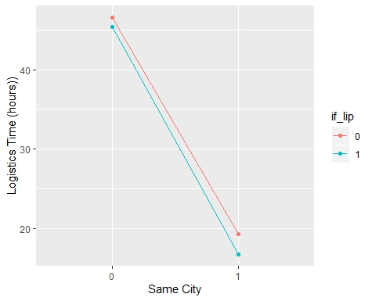
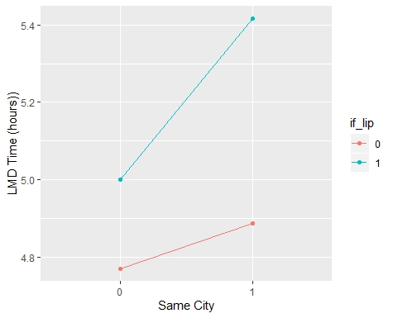
Use of LIP vs Same City Delivery (Interaction)
1.2 hours
0.53 hours
2.5 hours
0.23 hours
Notes:
One explicable reason why the LMD has a positive slope is because, majority of the deliveries (for same city) were in central cities (77%) and suburban (19%). These are areas with most traffic
For not same cities, the distribution were relatively even across city sizes (about 33% each)

Slide 4
Use of LIP vs Same City Delivery
There was a significant main effect of LIP, F = 1812, p <.001, such that Yes LIP (M= 39.4 , SD = 23.6) had a significantly lower long haul delivery time than NO LIP (M= 45.2 , SD = 22.3).
The main effect for same city was also significant F = 401k, p <.001, such that Yes Same city (M = 18.2, SD = 12.3) had significantly lower long haul delivery time than Not Same City (M = 46.4, SD = 21.9).
However, the interaction effect was significant, F = 425, p <.001, indicating the effect of using LIP on long haul delivery time depends on if it is within the same city or not.
On the contrary, the last mile delivery time showed that items dispatched without LIP were delivered faster than those with LIP
In addition, items dispatched and received within the same city takes longer time to be delivered compared to those in different cities.
The interaction effect was significant, F = 276, p <.001, indicating the effect of using LIP on last mile delivery depends on if it is within the same city or not.
To know the impact of LIP, we need to look into the nature of the cities deliveries are made to.

Slide 5
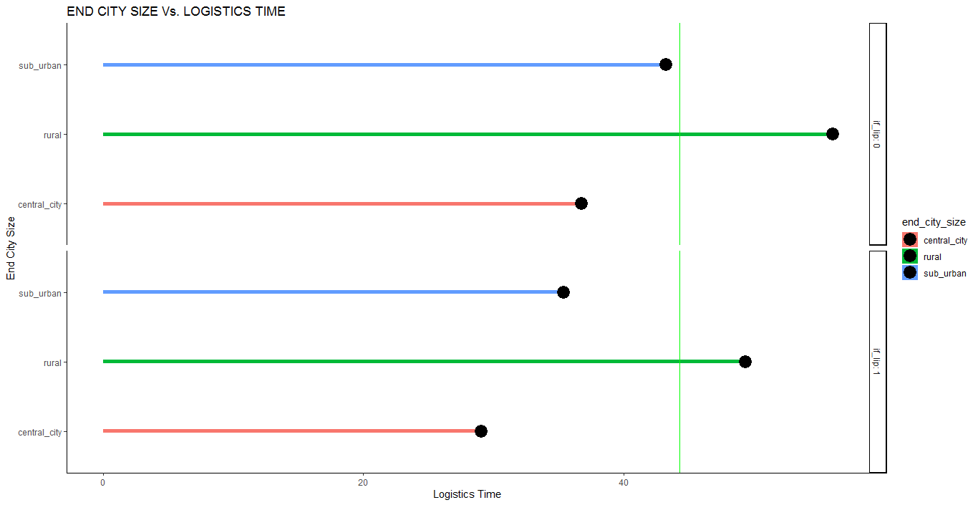
City Size & Logistics Time (T2)
Avg Logistics Time = 44.3066 hours
Relative comparison between with LIP and without LIP for each of the END CITY SIZE category reveals that with LIP LOGISTICS TIME was better

Slide 6
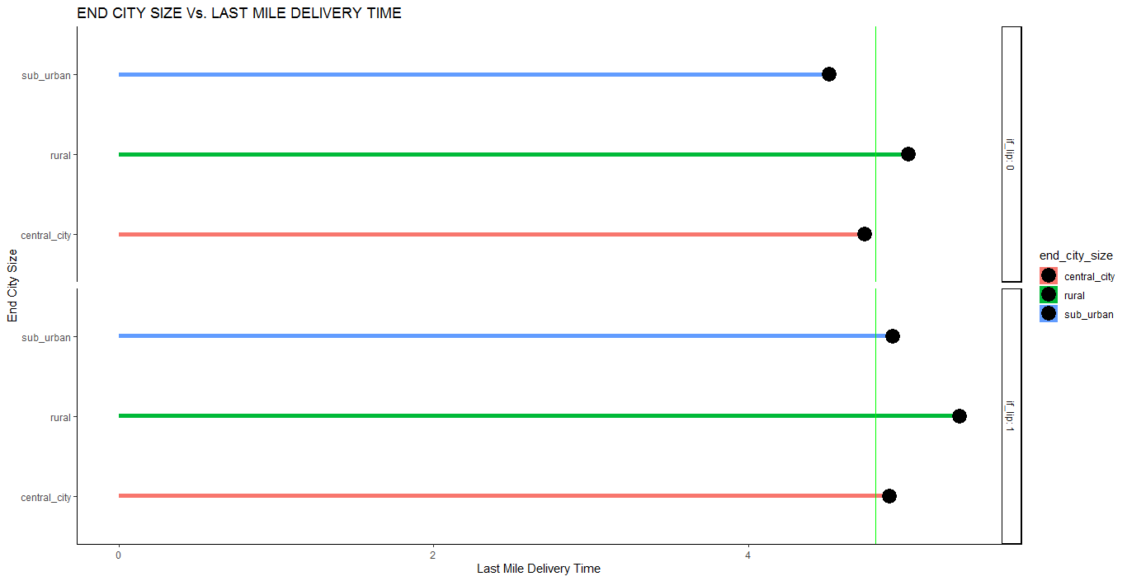
City Size & Last Mile Delivery Time (T3)
Avg Last Mile Delivery Time = 4.808 hours
Last Mile Delivery Time varies with End City Size
While Rural performs below par for without LIP when compared to Total Average T3, with LIP Rural, Sub-urban and Central city have suboptimal last mile delivery time

Slide 7
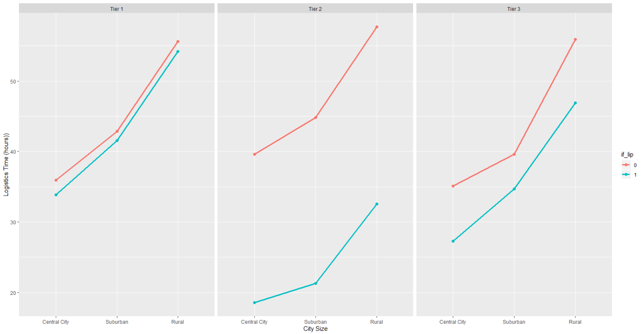
Effect of Logistic Company Size, End City and LIP on Logistics Time (T2)
City
Central City : >83,000 item orders
Suburban: >23,000 item orders
Rural : < 23,000 tem orders
Logistic Company
Tier1: >= 800,000 item orders
Tier 2: >= 300,000 item orders
Tier 3: <300,000 item orders
1.4 hours
9 hours
25 hours
1.2 hours
4.9 hours
23.5 hours
2.1 hours
21 hours
7.8 hours

Slide 8
Effect of Logistic Company Size, End City and LIP on Logistics Time (T2)
The line of marginal means for the long haul delivery time, shows that using LIP is better for delivery.
The average long haul delivery time increases with respect to from central city, suburban and rural areas irrespective of the size of logistics company used or if LIP is used.
Tier 2 logistics company that were used with LIP appears to have less delivery time, followed by Tier 3.
Albeit for Tier 1, difference between use of LIP and no use of LIP is relatively small.
The logistic time interaction effect between LIP and city size in all three logistic company tiers were significant: F (2,4493131) = 76.5, p <.001; F (2,1345436) = 549, p <.001; F (2,156208) = 91.2 p <.001 respectively for Tier 1, Tier 2 and Tier 3
This implies that the effect of using LIP considering the long haul delivery time given the Logistic company depends on the size of the city the delivery is to be made.

Slide 9
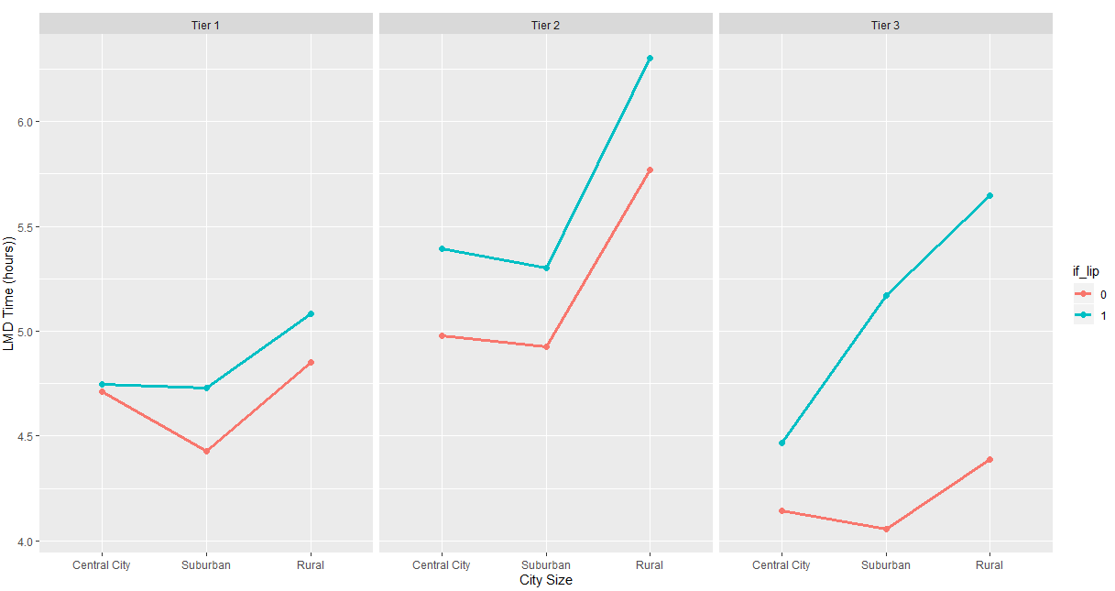
Effect of Logistic Company Size, End City and LIP on Last Mile Delivery Time (T3)
0.53 hours
0.37 hours
1.26 hours
0.23 hours
0.41 hours
0.3 hours
1.12 hours
0.04 hours
0.33 hours

Slide 10
Effect of Logistic Company Size, End City and LIP on Last Mile Delivery Time (T3)
The line of marginal means for last mile delivery time shows that the use of LIP resulted in longer last mile delivery time.
The last mile delivery time difference between the use of LIP and no LIP was seen to increase as the logistics company size decreases.
It takes longer time to deliver items in rural areas compared to suburban and central city areas.
This could be as a result of Cainiao collaboration with a larger number of cash-on-delivery logistics companies in rural areas. The receivers have to pay for the delivery fee to get the packages.
Same cannot be said for if the merchant decides to use no LIP
The logistic time interaction effect between LIP and city size in all three logistic company tiers were significant: F(2,4493131) = 102, p <.001; F (2,1345436)= 14, p <.001; F(2,156208) = 49.3, p <.001 respectively for Tier 1, Tier 2 and Tier 3
This implies that the effect of using LIP considering the last mile delivery time given the Logistic company depends on the size of the city the delivery is to be made.

Slide 11
Suggestions and Conclusion
Findings showed that last mile delivery time (irrespective of use of LIP or not) were higher in rural areas compared to suburban or central cities. This is consistent with the finding of Boyer, Prud’homme & Chung (2009).
It was observed that LIP performed better on long haul delivery time compared to last mile delivery (LMD) time. Improvements should be made on LMD time for LIP deliveries. One of such is To be specific, logistic companies under Tier 1 and Tier 2 should consider crowdsourcing as a means to improve LMD especially in rural areas.
The LIP should consider building urban warehouses with easy access to products for fast customer deliveries.
It was observed that the performance (in terms of LMD and long haul delivery time) of LIP logistics companies across the three tiers were not consistent. The LIP should make efforts to coordinate the logistics companies to ensure consistent performances
Using Big Data, the LIP can predict what customer might want, even if they didn’t order it. Hence a mobile warehouse model may be adopted. This model is gaining traction and has been used Amazon (Treasury Truck). Non-committed inventory can be loaded into delivery trucks, allowing drivers to upsell during the delivery process. (Business Insider, 2017)

Slide 12
References
Boyer K., Prud'homme A. and Chung W. (2009), The Last Mile Challenge: Evaluating the Effects of Customer Density and Delivery Window Patterns. Journal of Business Logistics, Vol. 30, No. 1
Business Insider (2017). 9 trends in last-mile delivery. Retrieved from https://www.supplychaindive.com/news/last-mile-spotlight-trends-tech-gig-perfect/443091/
Cynthia L. (2016). One Platform to Rule Them All. Retrieved from https://ecommerceiq.asia/cainiao-business-model-2/
Whale Dream Works - Noob Logistics (2017). Chinese version retrieved from https://www.youtube.com/watch?v=Mjlwy21-jpY&t=67s
Caijing Magazine. (2018)巨头物流之战. Retrieved from http://magazine.caijing.com.cn/20180604/4464643.shtml

